Slide 1
Binary Search Trees
<
6
2
>
9
1
4
=
8
© 2013 Goodrich, Tamassia, Goldwasser
Binary Search Trees
Notes:
Dictionaries

Slide 2


Ordered Maps
Keys are assumed to come from a total order.
Items are stored in order by their keys
This allows us to support nearest neighbor queries:
  Item with largest key less than or equal to k
  Item with smallest key greater than or equal to k
© 2013 Goodrich, Tamassia, Goldwasser
Binary Search Trees

Slide 3

Binary Search
Binary search can perform nearest neighbor queries on an ordered map that is implemented with an array, sorted by key
  similar to the high-low children’s game
  at each step, the number of candidate items is halved
  terminates after O(log n) steps
Example: find(7)
0
1
3
4
5
7
8
9
11
14
16
18
19
l
m
h
0
1
3
4
5
7
8
9
11
14
16
18
19
l
m
h
0
1
3
4
5
7
8
9
11
14
16
18
19
l
m
h
0
1
3
4
5
7
8
9
11
14
16
18
19
© 2013 Goodrich, Tamassia, Goldwasser
l=m =h
Binary Search Trees

Slide 4

Search Tables
A search table is an ordered map implemented by means of a sorted sequence
  We store the items in an array-based sequence, sorted by key
  We use an external comparator for the keys
Performance:
  Searches take O(log n) time, using binary search
  Inserting a new item takes O(n) time, since in the worst case we have to shift n items to make room for the new item
  Removing an item takes O(n) time, since in the worst case we have to shift n items to compact the items after the removal
The lookup table is effective only for ordered maps of small size or for maps on which searches are the most common operations, while insertions and removals are rarely performed (e.g., credit card authorizations)
© 2013 Goodrich, Tamassia, Goldwasser
Binary Search Trees

Slide 5
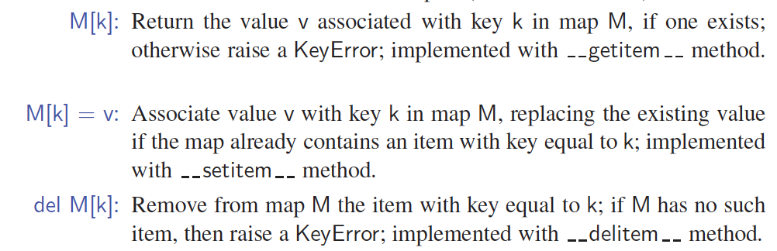
Sorted Map Operations
Standard Map methods:
The sorted map ADT includes additional functionality, guaranteeing that an iteration reports keys in sorted order, and supporting additional searches such as find_gt(k) and find_range(start, stop).
© 2013 Goodrich, Tamassia, Goldwasser
Binary Search Trees

Slide 6

Binary Search Trees
A binary search tree is a binary tree storing keys (or key-value items) at its nodes and satisfying the following property:
  Let u, v, and w be three nodes such that u is in the left subtree of v and w is in the right subtree of v. We have
  key(u) ≤ key(v) ≤ key(w)
External nodes do not store items, instead we consider them as None
An inorder traversal of a binary search trees visits the keys in increasing order
6
2
9
1
4
8
© 2013 Goodrich, Tamassia, Goldwasser
Binary Search Trees

Slide 7
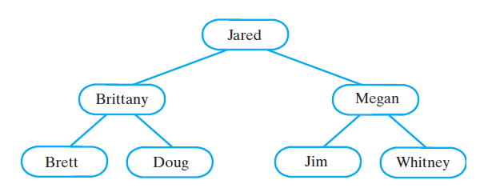
Binary Search Tree
A binary search tree of names

Slide 8
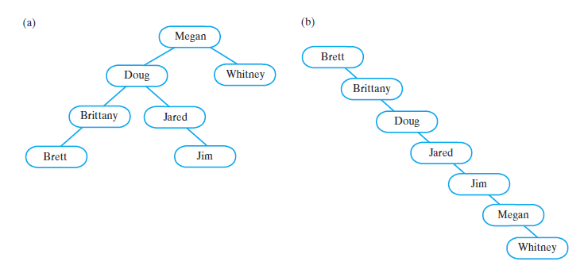
Binary Search Tree
Two BSTs containing the same data as the previous BST

Slide 9
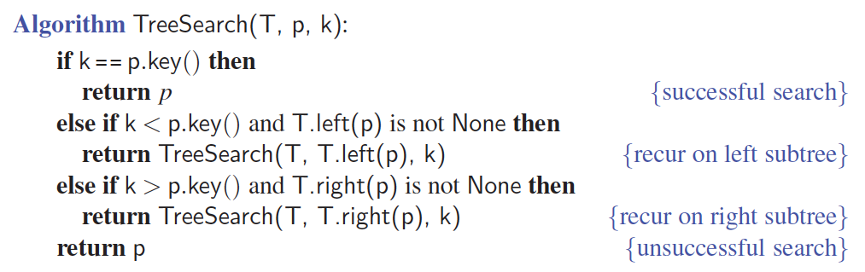
Search
To search for a key k, we trace a downward path starting at the root
The next node visited depends on the comparison of k with the key of the current node
If we reach a leaf, the key is not found
Example: find(4):
  Call TreeSearch(4,root)
The algorithms for nearest neighbor queries are similar
<
6
2
>
9
1
4
=
8
© 2013 Goodrich, Tamassia, Goldwasser
Binary Search Trees
Notes:
Dictionaries

Slide 10
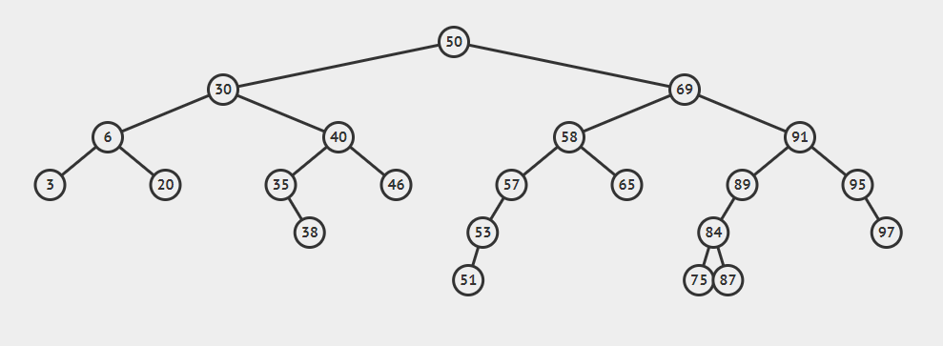
Successor of a node after(p)
© 2013 Goodrich, Tamassia, Goldwasser
Binary Search Trees
Notes:
Dictionaries

Slide 11
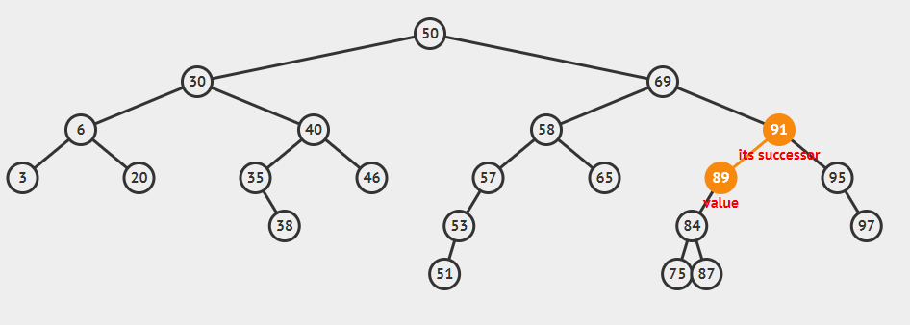
Successor of 89 is 91 after(89) = 91
© 2013 Goodrich, Tamassia, Goldwasser
Binary Search Trees

Slide 12
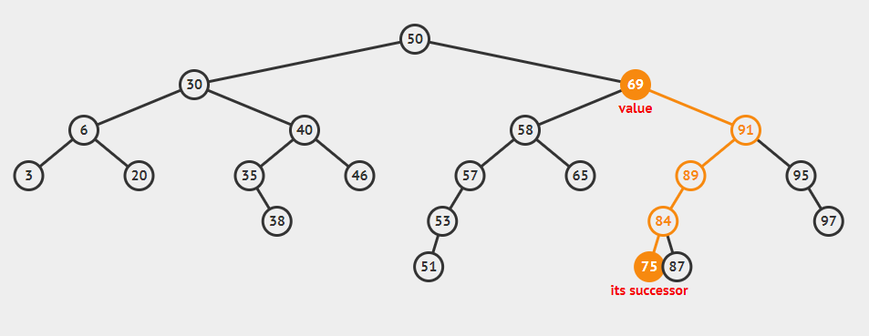
Successor of 69 is 75 after(69) = 75
© 2013 Goodrich, Tamassia, Goldwasser
Binary Search Trees

Slide 13
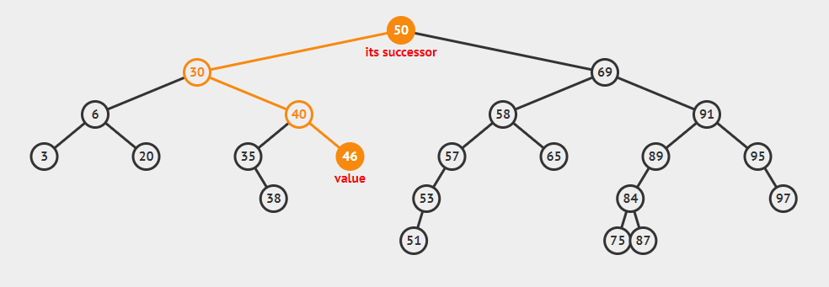
Successor of 46 is 50 after(46) = 50
© 2013 Goodrich, Tamassia, Goldwasser
Binary Search Trees

Slide 14
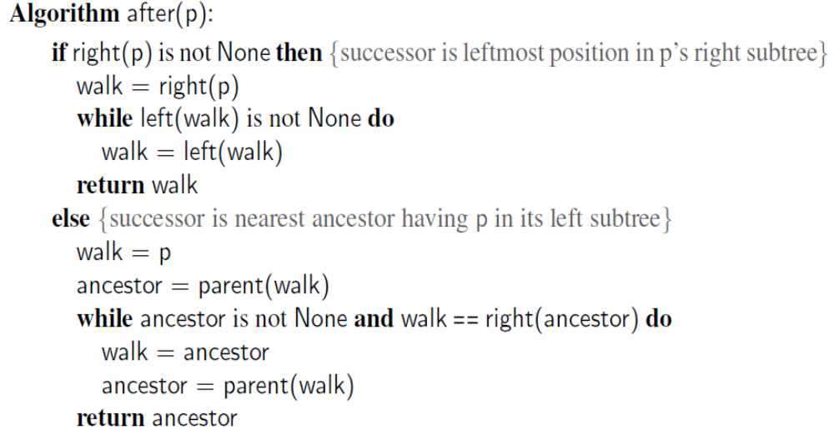
Algorithm for after(p)
© 2013 Goodrich, Tamassia, Goldwasser
Binary Search Trees

Slide 15
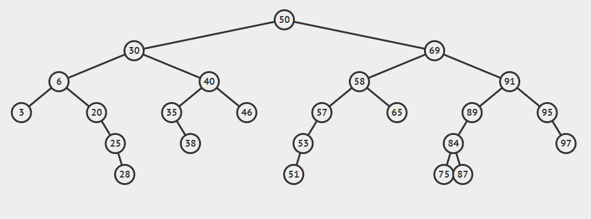
Predecessor of a node before(p)
© 2013 Goodrich, Tamassia, Goldwasser
Binary Search Trees
Notes:
Dictionaries

Slide 16
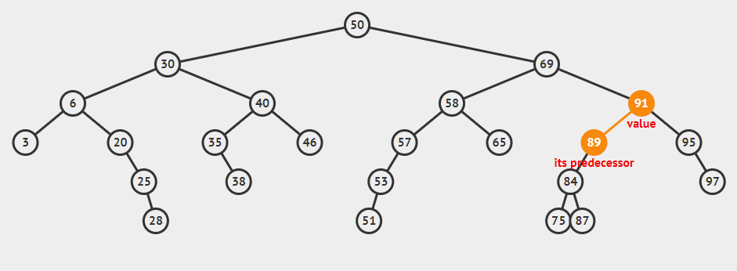
before(91) = 89
© 2013 Goodrich, Tamassia, Goldwasser
Binary Search Trees
Notes:
Dictionaries

Slide 17
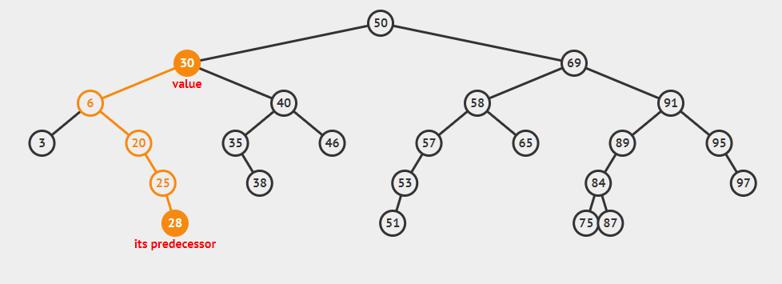
before(30) = 28
© 2013 Goodrich, Tamassia, Goldwasser
Binary Search Trees

Slide 18
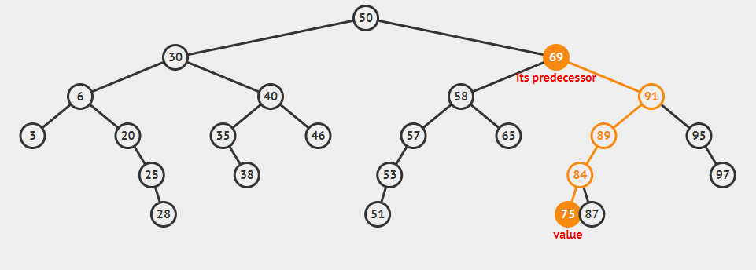
before(75) = 69
© 2013 Goodrich, Tamassia, Goldwasser
Binary Search Trees
Notes:
Dictionaries

Slide 19
Fast and Last
first( ): Return the position containing the least key, or None if the tree is empty.
last( ): Return the position containing the greatest key, or None if empty tree.
© 2013 Goodrich, Tamassia, Goldwasser
Binary Search Trees

Slide 20
What is first() and last() position for this binary tree?
© 2013 Goodrich, Tamassia, Goldwasser
Binary Search Trees
Notes:
The “first” position of a binary search tree can be located by starting a walk at
the root and continuing to the left child, as long as a left child exists. By symmetry,
the last position is reached by repeated steps rightward starting at the root.
Dictionaries

Slide 21
Insertion
<
6
To perform operation put(k, o), we search for key k (using TreeSearch)
Assume k is not already in the tree, and let w be the (None) leaf reached by the search
We insert k at node w and expand w into an internal node
Example: insert 5
2
>
9
1
4
>
8
w
6
2
9
1
4
8
w
5
© 2013 Goodrich, Tamassia, Goldwasser
Binary Search Trees

Slide 22
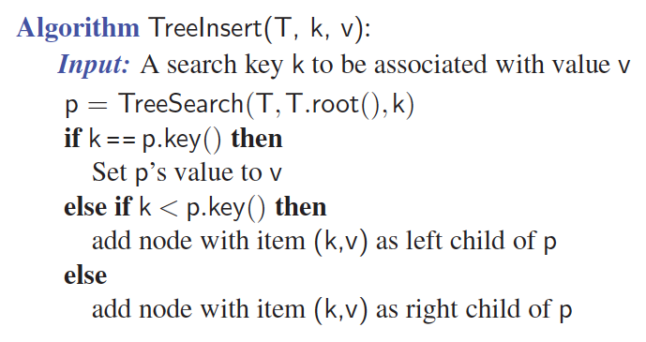
Insertion Pseudo-code
© 2013 Goodrich, Tamassia, Goldwasser
Binary Search Trees

Slide 23
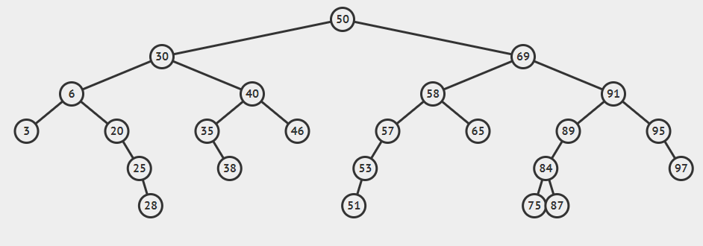
Insert 13 in this tree
© 2013 Goodrich, Tamassia, Goldwasser
Binary Search Trees

Slide 24
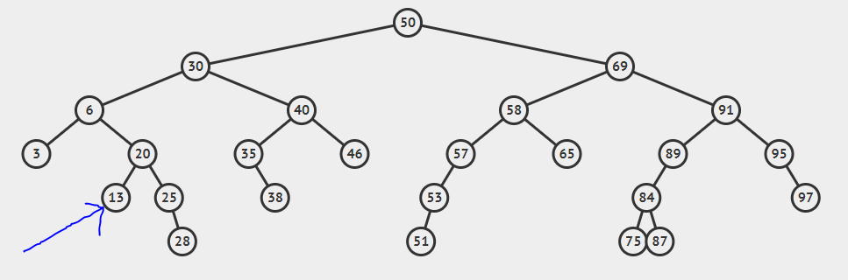
After inserting 13
© 2013 Goodrich, Tamassia, Goldwasser
Binary Search Trees

Slide 25
Deletion
To perform operation remove(k), we search for key k
Assume key k is in the tree, and let let v be the node storing k
If node v has a (None) leaf child w, we remove v and w from the tree with operation removeExternal(w), which removes w and its parent
Example: remove 4
<
6
2
>
9
1
4
v
8
w
5
6
2
9
1
5
8
© 2013 Goodrich, Tamassia, Goldwasser
Binary Search Trees

Slide 26
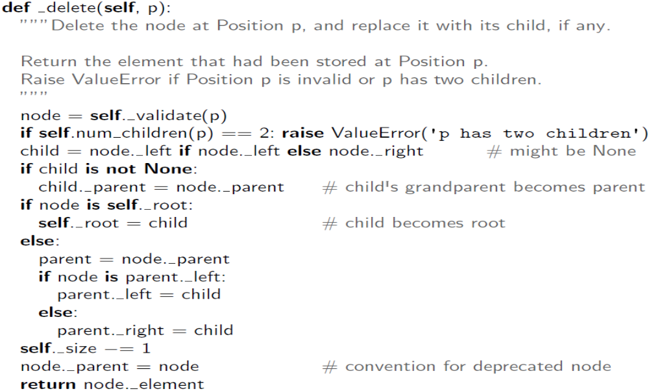
_delete method from LinkedBinaryTree Class
© 2013 Goodrich, Tamassia, Goldwasser
Binary Search Trees

Slide 27
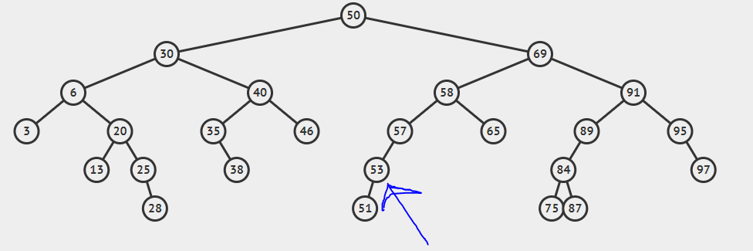
delete(53)
53 has just one child.
© 2013 Goodrich, Tamassia, Goldwasser
Binary Search Trees

Slide 28
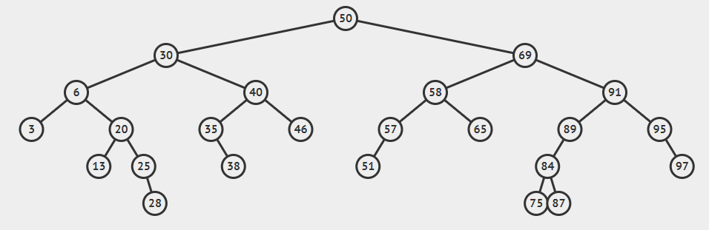
After deleting 53
© 2013 Goodrich, Tamassia, Goldwasser
Binary Search Trees
Notes:
Dictionaries

Slide 29
Deletion (cont.)
1
v
We consider the case where the key k to be removed is stored at a node v whose children are both internal
  we find the internal node w that follows v in an inorder traversal
  we copy key(w) into node v
  we remove node w and its left child z (which must be a leaf) by means of operation removeExternal(z)
Example: remove 3
3
2
8
6
9
w
5
z
1
v
5
2
8
6
9
© 2013 Goodrich, Tamassia, Goldwasser
Binary Search Trees

Slide 30
delete(69)
69 has two children.
© 2013 Goodrich, Tamassia, Goldwasser
Binary Search Trees
Notes:
Dictionaries

Slide 31
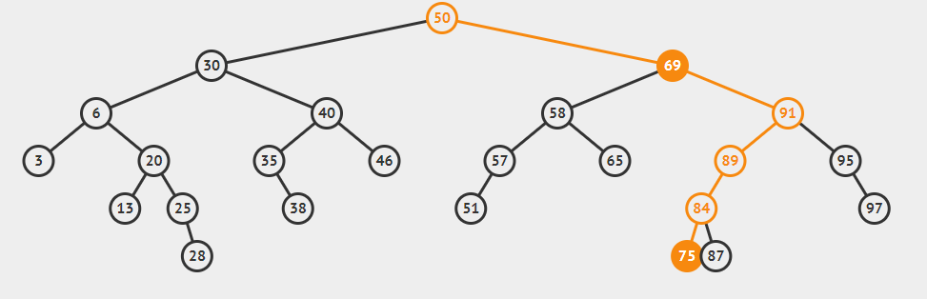
Let’s find successor of 69 after(69) = 75, replace 69 with 75 and then delete 69.
© 2013 Goodrich, Tamassia, Goldwasser
Binary Search Trees

Slide 32
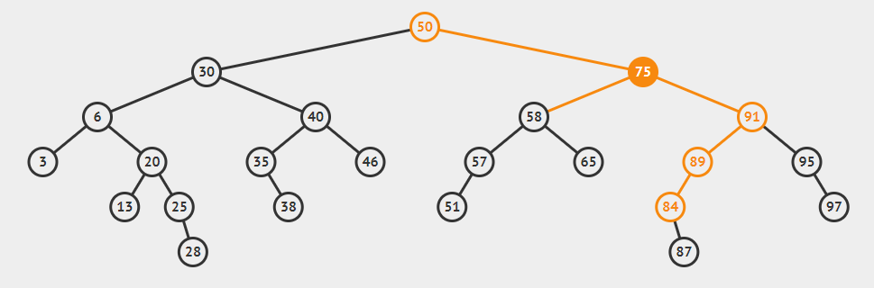
After removing 69
© 2013 Goodrich, Tamassia, Goldwasser
Binary Search Trees

Slide 33
Performance
Consider an ordered map with n items implemented by means of a binary search tree of height h
  the space used is O(n)
  Search and update methods take O(h) time
The height h is O(n) in the worst case and O(log n) in the best case
© 2013 Goodrich, Tamassia, Goldwasser
Binary Search Trees

Slide 34
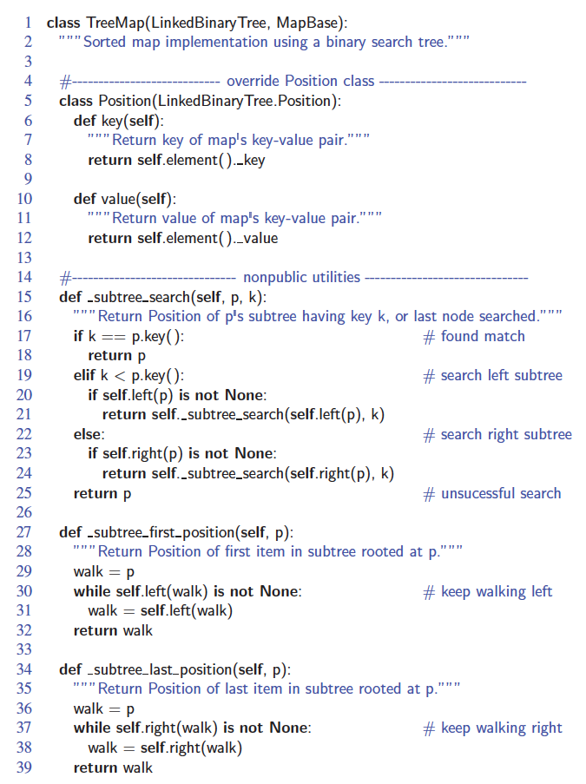
Python Implementation
© 2013 Goodrich, Tamassia, Goldwasser
Binary Search Trees

Slide 35
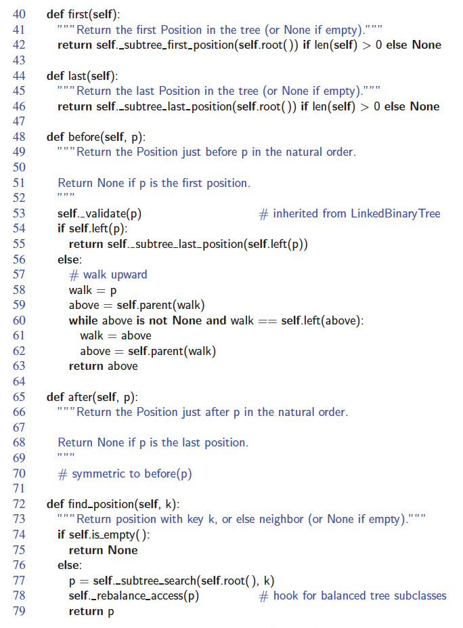
Python Implementation, Part 2
© 2013 Goodrich, Tamassia, Goldwasser
Binary Search Trees

Slide 36
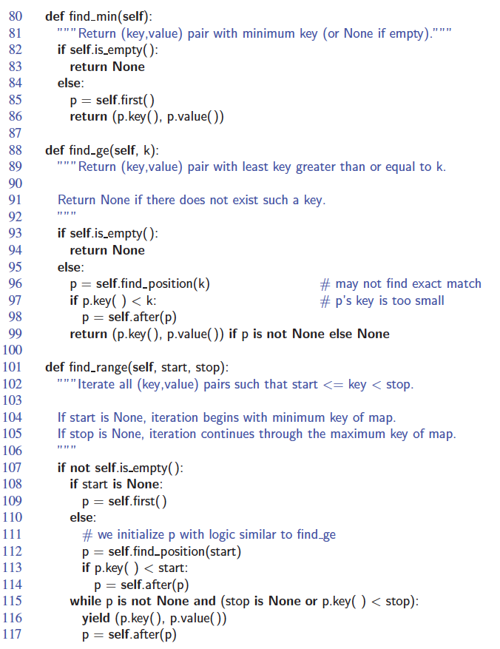
Python Implementation, Part 3
© 2013 Goodrich, Tamassia, Goldwasser
Binary Search Trees

Slide 37
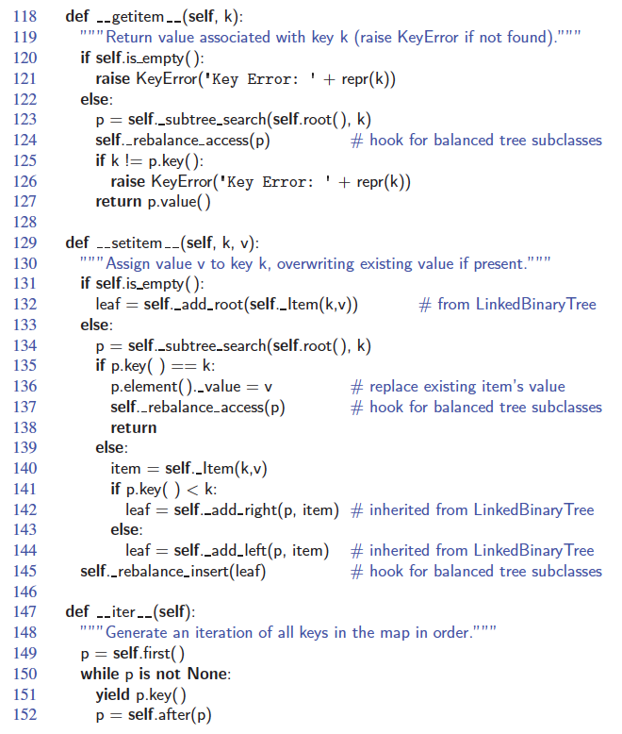
Python Implementation, Part 4
© 2013 Goodrich, Tamassia, Goldwasser
Binary Search Trees

Slide 38
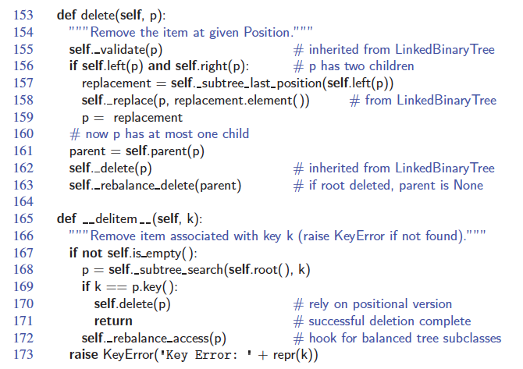
Python Implementation, end
© 2013 Goodrich, Tamassia, Goldwasser
Binary Search Trees

Slide 39
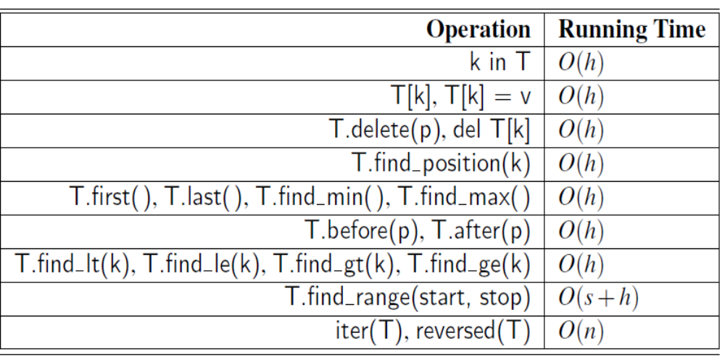
Performance of BST
Space usage is O(n), where n is the number of items
stored in the map.
© 2013 Goodrich, Tamassia, Goldwasser
Binary Search Trees

Slide 40
Animation for BST
https://visualgo.net/bn/bst
© 2013 Goodrich, Tamassia, Goldwasser
Binary Search Trees

